Slide 1
Lurz & Krachun (2011)
Notes:
robert Lurz

Slide 2
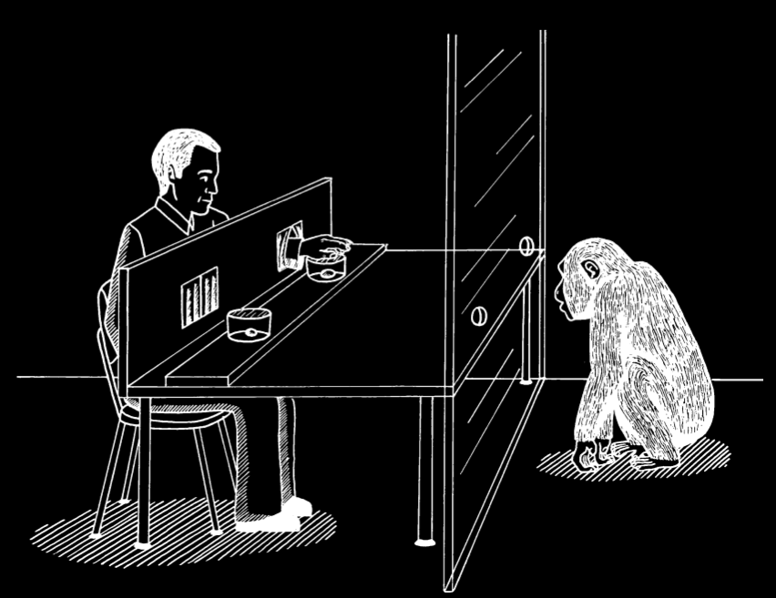
Lurz & Krachun (2011)
Notes:
robert Lurz

Slide 3

“all complementary behavior-reading hypotheses take animals’ predictions of agents’ behavior to be reality-based. [...] a complementary behavior-reading hypothesis ... would predict that chimpanzees would come to understand ... that the competitor is disposed to reach for the grape that is in fact the largest.”
Notes:
Metarep conjecture

Slide 4
(a) objective looks (Martin 2011) (the fruit bowl looks full from here but empty from there) (haircut looks good from the front but not the side)
Notes:
Metarep conjecture

Slide 5
(a) objective looks (Martin 2011) (the fruit bowl looks full from here but empty from there) (haircut looks good from the front but not the side)
The grape, which is small, looks large in this context.
Notes:
Metarep conjecture

Slide 6
(a) objective looks (Martin 2011) (the fruit bowl looks full from here but empty from there) (haircut looks good from the front but not the side)
The grape, which is small, looks large in this context. Looks large(grape) = has a look characteristic of large grapes
Notes:
Metarep conjecture

Slide 7
(a) objective looks (Martin 2011) (the fruit bowl looks full from here but empty from there) (haircut looks good from the front but not the side)
The grape, which is small, looks large in this context. Looks large(grape) = has a look characteristic of large grapes
(b) accessibility of objective look properties (the fruit bowl’s full look cannot be accessed from there)
Notes:
Metarep conjecture

Slide 8
(a) objective looks (Martin 2011) (the fruit bowl looks full from here but empty from there) (haircut looks good from the front but not the side)
The grape, which is small, looks large in this context. Looks large(grape) = has a look characteristic of large grapes
(b) accessibility of objective look properties (the fruit bowl’s full look cannot be accessed from there)
My competitor has only had access to contexts in which the grape looks large.
Notes:
Metarep conjecture

Slide 9
(a) objective looks (Martin 2011) (the fruit bowl looks full from here but empty from there) (haircut looks good from the front but not the side)
The grape, which is small, looks large in this context. Looks large(grape) = has a look characteristic of large grapes
(b) accessibility of objective look properties (the fruit bowl’s full look cannot be accessed from there)
My competitor has only had access to contexts in which the grape looks large.
(c) action predictions based on where one has been and which looks were accessible from there
Notes:
Metarep conjecture

Slide 10
(a) objective looks (Martin 2011) (the fruit bowl looks full from here but empty from there) (haircut looks good from the front but not the side)
The grape, which is small, looks large in this context. Looks large(grape) = has a look characteristic of large grapes
(b) accessibility of objective look properties (the fruit bowl’s full look cannot be accessed from there)
My competitor has only had access to contexts in which the grape looks large.
(c) action predictions based on where one has been and which looks were accessible from there
If x has only ever had access to contexts in which grape-1 looks large and grape-2 looks small, then x will prefer grape-1 over grape-2.
Notes:
Metarep conjecture

Slide 11
(a) objective looks (Martin 2011) (the fruit bowl looks full from here but empty from there) (haircut looks good from the front but not the side)
The grape, which is small, looks large in this context. Looks large(grape) = has a look characteristic of large grapes
(b) accessibility of objective look properties (the fruit bowl’s full look cannot be accessed from there)
My competitor has only had access to contexts in which the grape looks large.
(c) action predictions based on where one has been and which looks were accessible from there
If x has only ever had access to contexts in which grape-1 looks large and grape-2 looks small, then x will prefer grape-1 over grape-2.
Notes:
Metarep conjecture

